Slide 1







Files and Errors
Working with the File System, Handling Errors
Files
SoftUni Team
Technical Trainers
try-catch
Software University
http://softuni.bg

Slide 2



Table of Contents
Working with Files and Directories
Getting info on Files
Renaming/Moving/Deleting
Traversing Directories
Errors
Raising Errors
Catching Errors

Slide 3
Questions?
sli.do #python-fund

Slide 4

Working with Files and Directories
Stats, Renaming, Moving, Deleting

Slide 5
Opening Files
To work with a file in Python we must first open() it:
Access mode (default: read-only):
'r' – read-only
'w' – write-only
'a' – append (creates file if it doesn’t exist)
If 'b' is added, the file is opened in binary format (as bytes) (e.g. 'rb')
If + is added to the end, the file gets open in both modes (read+write, etc.)
with open(file_name [,access_mode]) as f:
# do stuff with file

Slide 6
Reading from Files
To read a file’s entire contents, we can use file.read():
To read line by line, we can use file.readline():
with open('text.txt' 'r') as f:
print(f.read())
lines = []
with open('text.txt' 'r') as f:
lines.append(f.readline())
while line is not '':
lines.append(f.readline())

Slide 7
Writing to Files
To write to a file, we can use file.write():
We can use writelines(list) to write a list of strings:
Iterates over list and calls write() on each element (very slow!)
with open('text2.txt', 'w') as f:
f.write('Hello\nThere!')
text2.txt
Hello
There!
with open('text2.txt', 'w') as f:
f.writelines(['Hello\n', 'There!'])
text2.txt
Hello
There!

Slide 8
File Object Attributes
file.closed – returns True if file is closed
file.mode – returns the mode the file has been opened in
file.name – returns the name of the file
info = open('info.txt', 'w+') # Read+Write access mode
print('Name:', info.name)
print('Mode:', info.mode)
print('Is the file opened:', not info.closed)

Slide 9
Problem: Odd Lines
Write a program to read a text file lines.txt and extract its odd lines (starting from 0) in a text file odd-lines.txt
lines.txt
odd-lines.txt
Two households, both alike in dignity,
In fair Verona, where we lay our scene,
From ancient grudge break to new mutiny,
Where civil blood makes civil hands unclean.
From forth the fatal loins of these two foes
A pair of star-cross'd lovers take their life;
Whose misadventured piteous overthrows
Do with their death bury their parents' strife.
In fair Verona, where we lay our scene,
Where civil blood makes civil hands unclean.
A pair of star-cross'd lovers take their life;
Do with their death bury their parents' strife.

Slide 10
Solution: Odd Lines
Solution, which reads and writes line-by-line:
with open('lines.txt') as lines_file:
with open('odd-lines.txt', 'w') as odd_file:
line = None
while line != '':
even_line = lines_file.readline()
odd_line = lines_file.readline()
odd_file.write(odd_line)
Discard the even line

Slide 11
Solution: Odd Lines
Solution, which reads the entire file and splits it into a list:
Open, read contents and close
lines = open('lines.txt').read().split('\n')
odd_lines = \
[line for index, line in enumerate(lines) if index % 2 == 1]
open('odd_lines.txt', 'w').write('\n'.join(odd_lines))

Slide 12
Problem: Insert Line Numbers
Read a text file input.txt line by line
Insert line numbers in front of each line (start by 1)
Write the result in a text file output.txt
first line
second line
third line
fourth line
fifth line
1. first line
2. second line
3. third line
4. fourth line
5. fifth line

Slide 13
Solution: Line Numbers
Reading all the lines and adding numbers to them:
lines = open(r'input.txt').read().split('\n')
lines_with_nums = \
[f'{index+1}. {line}' for index, line in enumerate(lines)]
open('output.txt', 'w').write('\n'.join(lines_with_nums))

Slide 14
Inspecting Files with os.stat()
Use os.stat('filename') to get information about a file:
st_size for file size in bytes:
st_ctime/st_mtime for creation/modification time
import os, datetime
info = os.stat('info.txt')
print(f'Size: {info.st_size // 1024}KB')
print("Created on:",
datetime.datetime.fromtimestamp(info.st_ctime))

Slide 15
Renaming and Deleting Files
os.rename(current_name, new_name) renames a file
os.remove(file_name) deletes a file
import os
os.rename('something.py', 'task0.py')
import os
os.remove('deleteme.txt')

Slide 16
Working with Directories
Traversing Directories, etc.

Slide 17

Basic Directory Operations
Creating a directory with os.mkdir(path):
Creating a directory tree with os.makedirs(path):
Deleting a directory (directory must be empty):
os.mkdir("TestFolder")
os.makedirs("TestFolder/Subdir/Subdir 2/")
os.rmdir("TestFolder")

Slide 18
Listing Directory Contents
We can traverse the folder structure with os.walk(path)
import os
for root, dirs, files in os.walk('.'):
# print path to all subdirectories first.
for subdir in dirs:
print(subdir)
# print path to all filenames.
for file in files:
print(file)

Slide 19
Problem: Calculate Folder Size
You are given a folder named TestFolder
Calculate the size of all files in the folder (without subfolders)
Print the result in a file output.txt" in Megabytes
output.txt
5.16173839569092

Slide 20
Solution: Calculate Folder Size
Use os.stat(path).st_size:
import os
root, dirs, files = next(os.walk('./TestFolder'))
sizes = [os.stat(file).st_size for file in files]
total_size = sum(sizes)
total_size_mb = total_size / 1024 / 1024
open('Output.txt', 'w').write(str(total_size_mb))

Slide 21
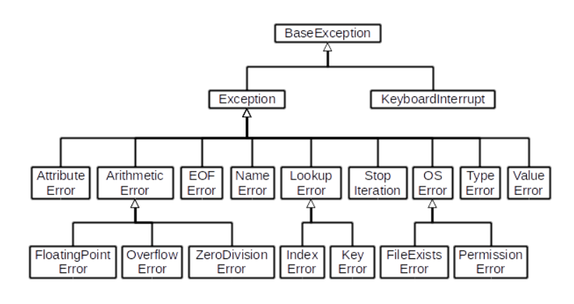
Errors and Exceptions
Raising and Handling

Slide 22
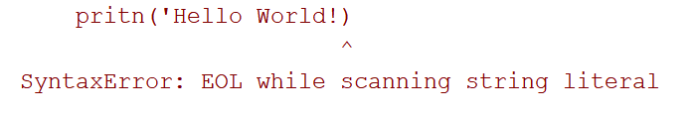
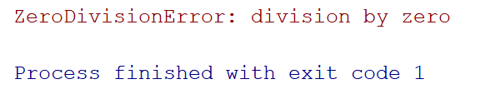
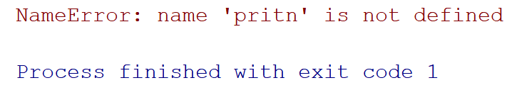
Errors and Exceptions
Python has Syntax Errors and Exceptions:
Syntax Errors are raised on incorrect syntax:
Exceptions are raised in unexpected scenarios:
print('Hello World!)
print(1 / 0)
pritn('Hello World!)

Slide 23
Raising Exceptions Manually
We can manually raise exceptions, using raise:
from math import sqrt
def sqrt_with_validation(num):
if num < 0:
raise ValueError('Negative number provided!')
return sqrt(num)
print(sqrt_with_validation(16)) # 4
print(sqrt_with_validation(-9)) # will raise error
print(sqrt_with_validation(16)) # will not execute
Exception Message

Slide 24
Handling Exceptions
We can handle exceptions, using the try, except block:
def convert(input_str):
try:
result = int(input_str)
return result
except ValueError:
print('non-numeric value provided!')
print(convert('16')) # 16
print(convert('pesho')) # will raise ValueError
print(convert('2')) # will not execute

Slide 25

Files and Errors
Live Exercises in Class

Slide 26
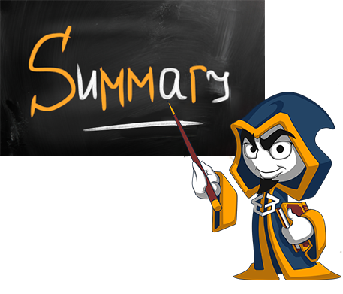
Summary
We can work with files, using the open() function
Get info about a file with os.stat()
Traverse Directories, using os.walk()
Raising and handling exceptions

Slide 27






SoftUni Diamond Partners

Slide 28






SoftUni Diamond Partners

Slide 29







Files and Errors
https://softuni.bg/courses/

Slide 30

License
This course (slides, examples, demos, videos, homework, etc.) is licensed under the "Creative Commons Attribution-NonCommercial-ShareAlike 4.0 International" license
Attribution: this work may contain portions from
"Fundamentals of Computer Programming with C#" book by Svetlin Nakov & Co. under CC-BY-SA license
Icons from http://www.flaticon.com/ (credits: Freepik, Madebyoliver)
30
Notes:
© Software University Foundation – http://softuni.org
This work is licensed under the Creative Commons Attribution-NonCommercial-ShareAlike license.
30

Slide 31




Trainings @ Software University (SoftUni)
Software University – High-Quality Education, Profession and Job for Software Developers
softuni.bg
Software University Foundation
http://softuni.foundation/
Software University @ Facebook
facebook.com/SoftwareUniversity
Software University Forums
forum.softuni.bg
Notes:
© Software University Foundation – http://softuni.org
This work is licensed under the Creative Commons Attribution-NonCommercial-ShareAlike license.
31

